Slide 1
Data Analysis( ETL)
1. Define ETL and explain its importance in data management.
ETL stands for Extract, Transform, Load. It is a data integration process used to combine data from multiple sources, transform the data into a format suitable for analysis, and load it into a target system, often a data warehouse.
Extract: Collecting data from different sources such as databases, applications, and files. I fetch my data from Kaggle .My Data is winner of R1 Racing Car.
Link-- https://www.kaggle.com/datasets/lakshayjain611/f1-races-results-dataset-1950-to-2024?select=winners.csv
Transform: Cleaning, enriching, and converting the data into a usable format. This step can include filtering, sorting, aggregating, and removing duplicates.
Load: Inserting the transformed data into a target database or data warehouse.
Importance:

Slide 2
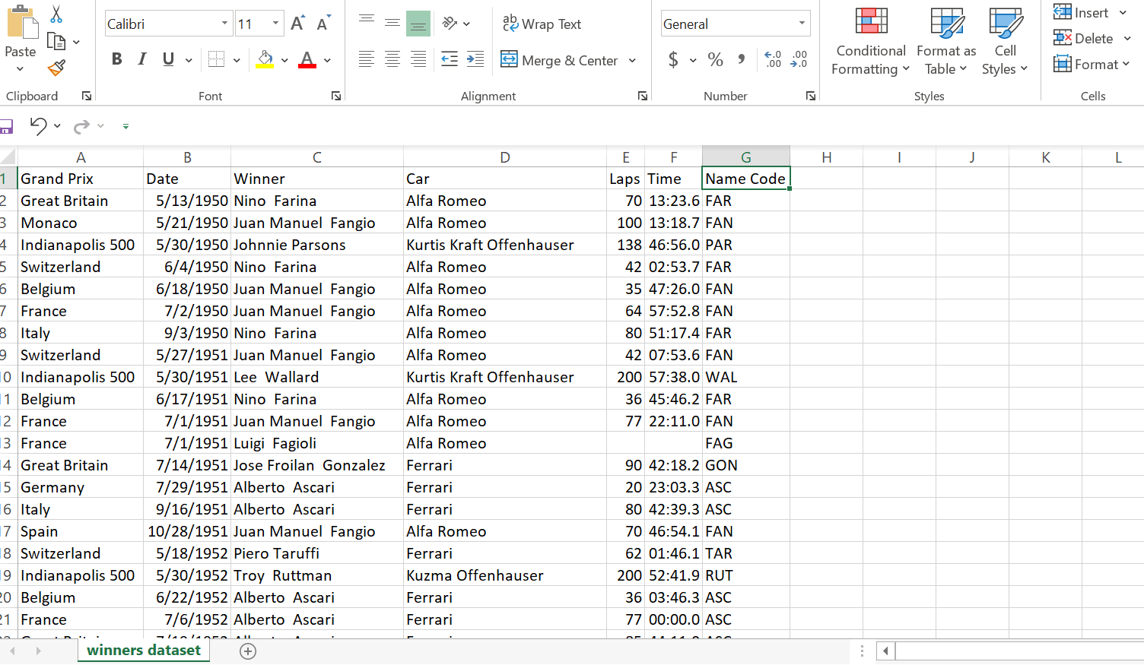
DATASET(Winner Of R1 Car Racing)

Slide 3
2. Describe a scenario where ETL could be beneficial in a business setting
Scenario: A retail company wants to analyze sales performance across multiple regions and product lines.
Benefit:
Extract: Data is extracted from various systems such as point-of-sale systems, online sales platforms, and inventory databases.
Transform: The data is cleaned to remove errors, standardized into a common format, and enriched by adding geographical and product categorization.
Load: The transformed data is loaded into a centralized data warehouse.
This data allows the company to generate comprehensive sales reports, identify trends, and make strategic decisions regarding inventory management and marketing efforts.

Slide 4
3. What challenges might a data analyst face during the transformation phase of ETL and how can they be addressed?
Challenges:
Data Quality Issues: Inconsistent, incomplete, or incorrect data.
Solution: I use data validation and cleansing techniques.
Data Transformations: Transforming data from different formats and structures.
Find Out suitable data.
Data Lineage: Tracking the data source and transformation steps.
Solution: Implement data lineage tracking within the ETL process to ensure transparency and traceability.

Slide 5
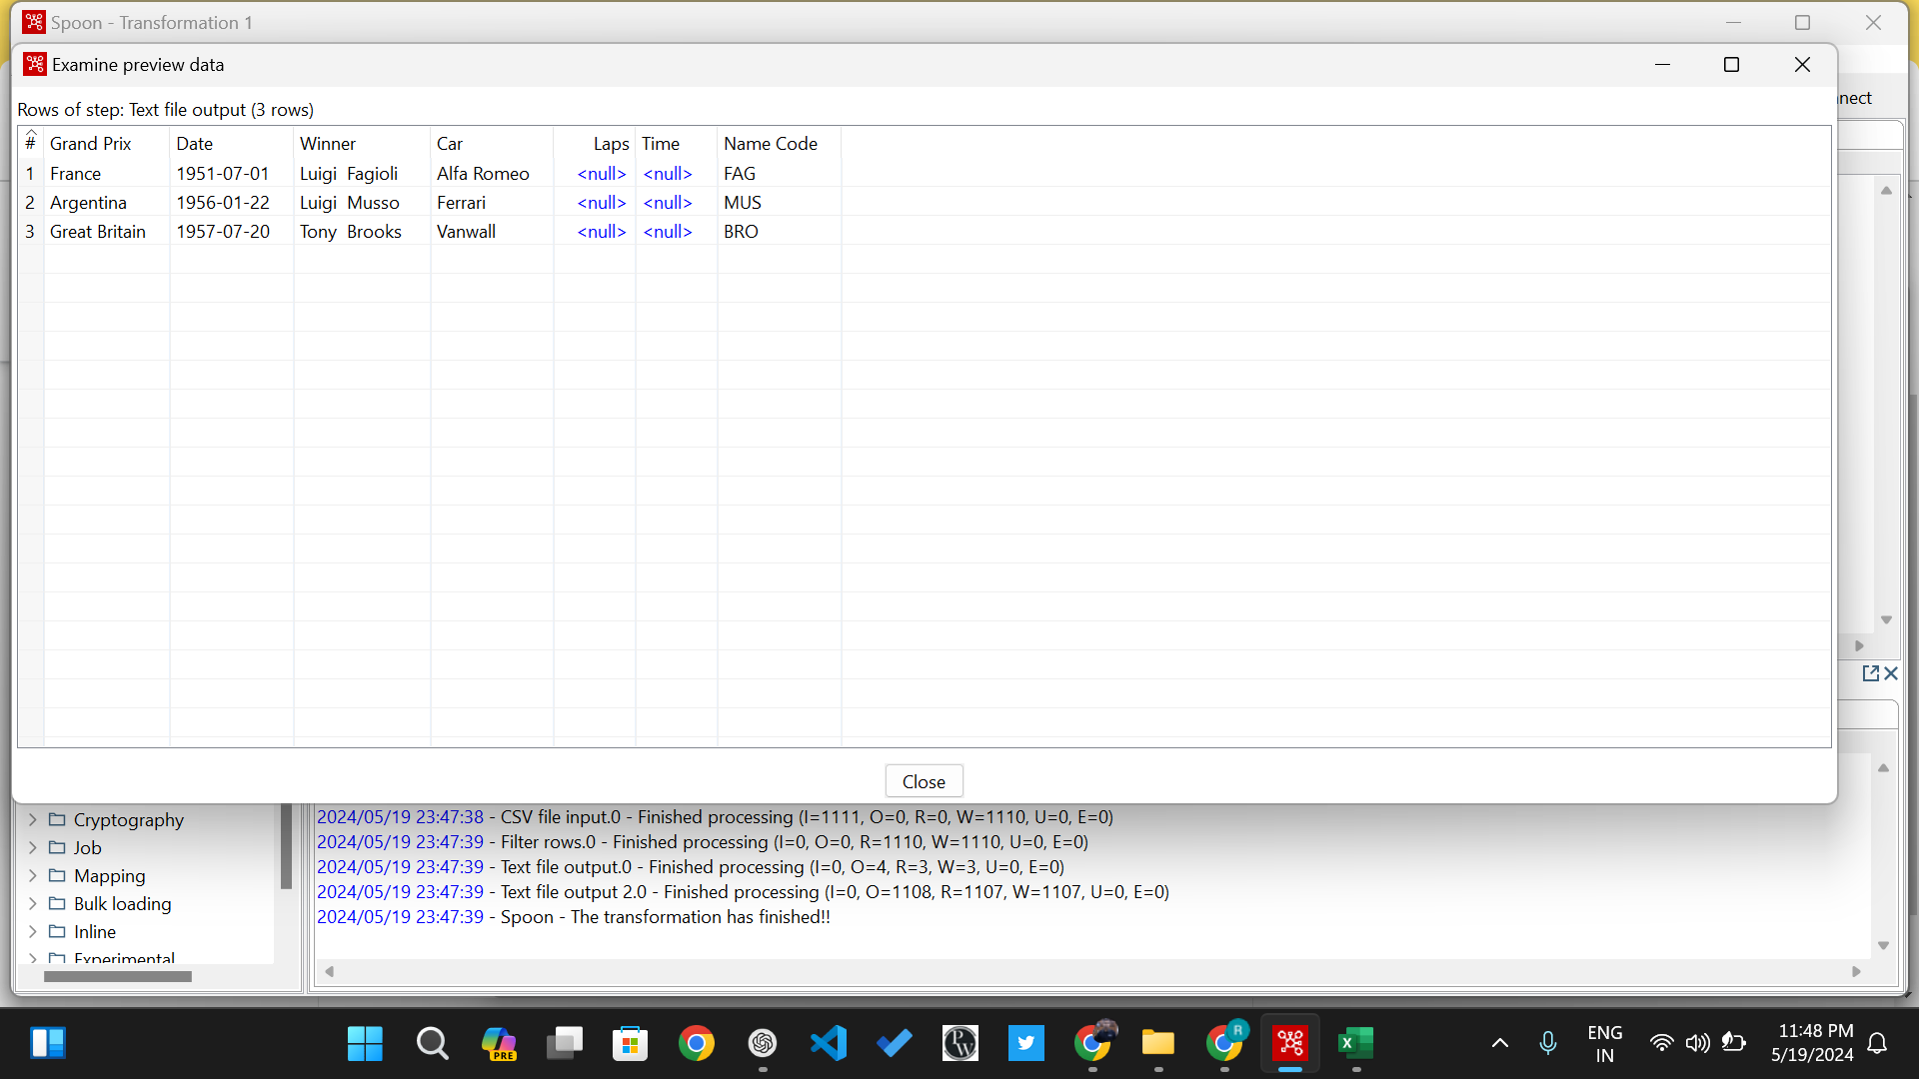

Slide 6
4. Explain the concept of data warehousing and its relationship with ETL processes.
Relationship with ETL:
ETL processes are essential for feeding data into the data warehouse.
ETL ensures that data is accurate, consistent, and in a format suitable for analysis.
The data warehouse relies on ETL to provide clean and organized data for business intelligence purposes.
The Source where we store the historical data, is called Data Warehouse.

Slide 7
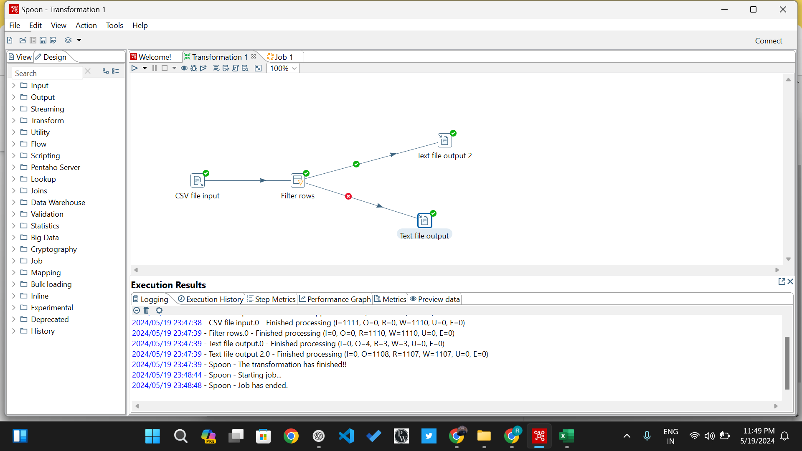

Slide 8
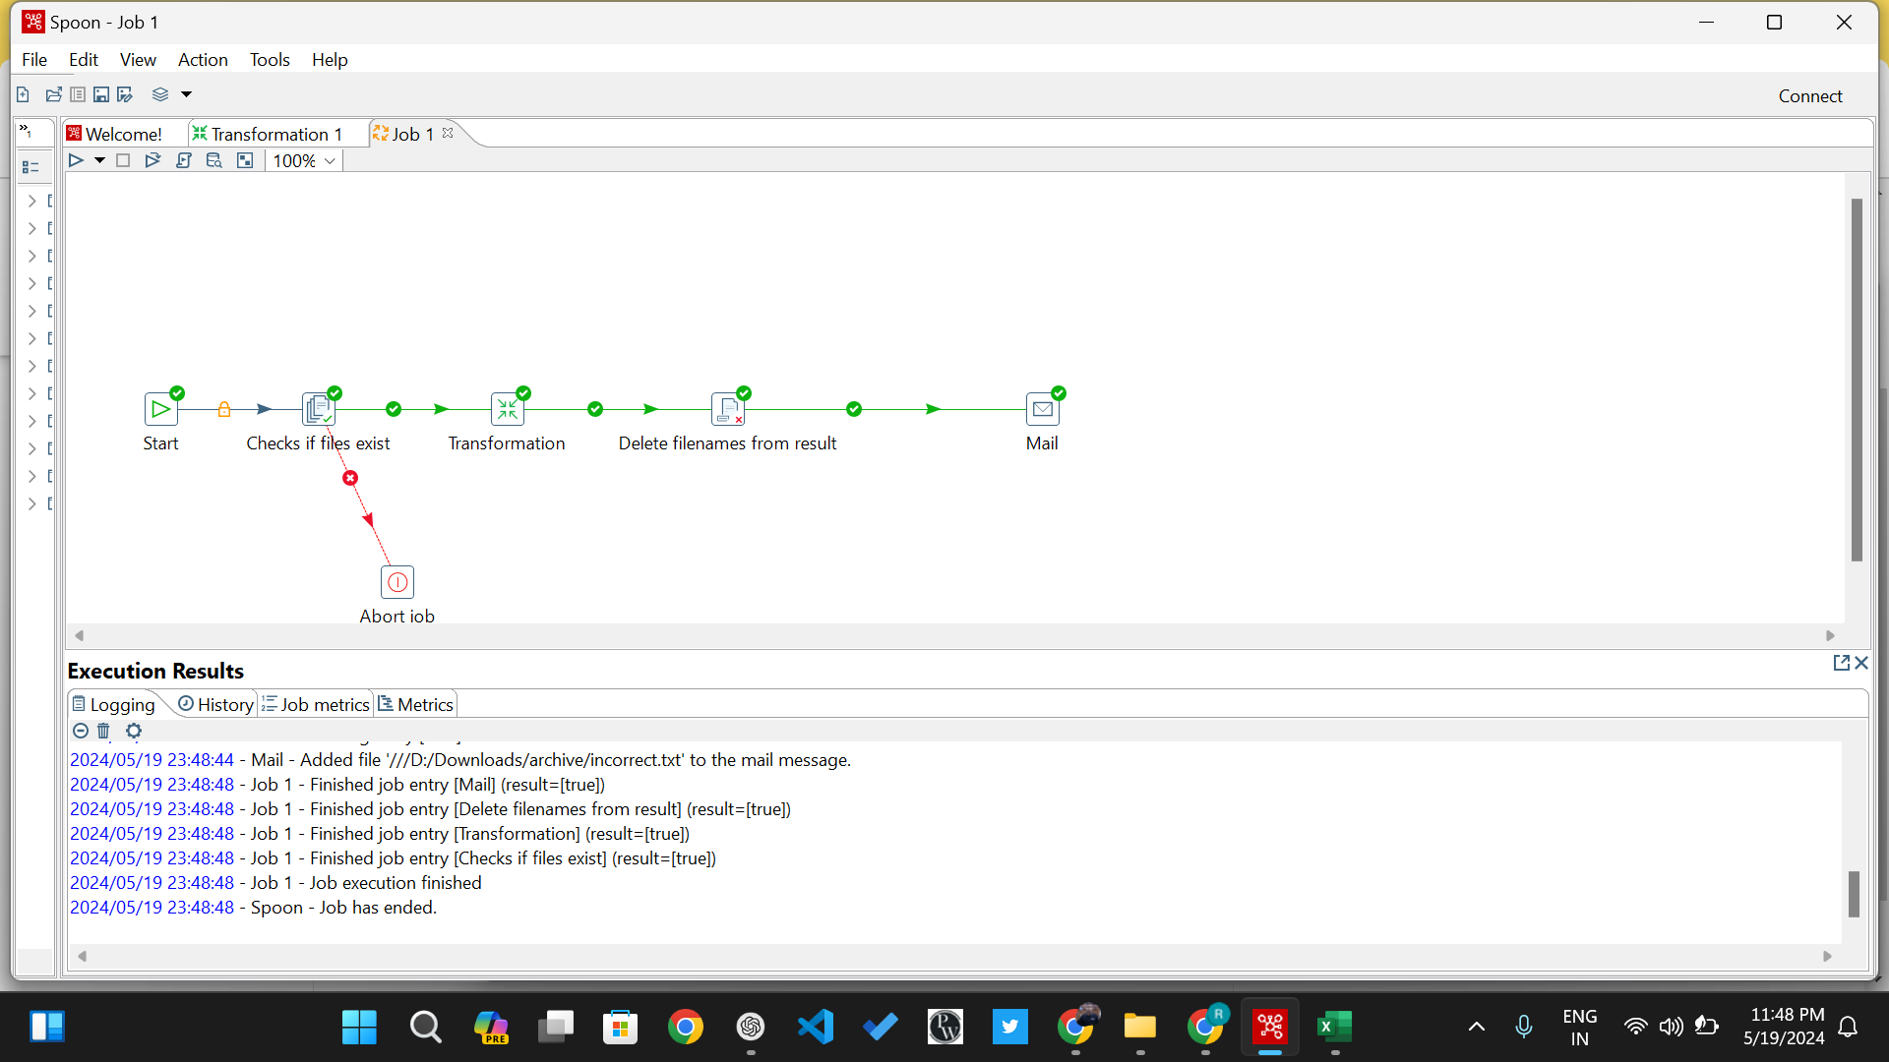

Slide 9
5. Define a database and a data warehouse.
Database: A collection of organized data stored electronically, typically in a structured format such as tables.
Data Warehouse: A specialized type of database optimized for querying and analysis. It aggregates data from multiple sources, storing historical data to support business intelligence activities.

Slide 10
6. How do the purposes of a database and a data warehouse differ in a business environment?
Database: Used for day-to-day operations, transactional processing, and real-time data management. It supports applications that require quick access to current data.
Data Warehouse: Used for long-term data storage, historical data analysis, and decision support. It supports business intelligence activities by providing a comprehensive view of data over time.

Slide 11
7. Can you illustrate with an example when you would use a database versus a data warehouse?
Example:
Database: An e-commerce website uses a database to manage its product catalog, customer information, and orders. It supports real-time operations such as browsing products, placing orders, and updating inventory.
Data Warehouse: The same e-commerce company uses a data warehouse to analyze sales trends, customer behavior, and inventory levels over the past five years. This analysis helps in strategic planning, marketing campaigns, and inventory management.

Slide 12
8. List 5 Popular Data Warehouse, ETL Tools, and Databases.
Data Warehouses: Databases:
Amazon Redshift .MySQL
Google BigQuery . PostgreSQL
Snowflake . Oracle Database
Microsoft Azure Synapse Analytics . Microsoft SQL Server
Teradata .MongoDB
ETL TOOLS
Apache Nifi
Talend
Informatica PowerCenter
Microsoft SQL Server Integration Services (SSIS)
Apache Airflow

Slide 13
9. Who is a Data Analyst, Business Analyst, and Data Scientist?
Data Analyst: Focuses on collecting, processing, and performing statistical analyses on data. They use data to provide actionable insights and support decision-making.
Business Analyst: Focuses on bridging the gap between IT and business. They analyze business processes, identify needs, and propose solutions to improve efficiency and effectiveness.
Data Scientist: Uses advanced analytical techniques, machine learning, and statistical models to analyze complex data sets. They extract insights and build predictive models to solve business problems.

Slide 14
10. Illustrate with an example how data visualization can assist in business decision-making.
Example: A marketing team wants to understand the performance of their latest campaign across different regions and customer segments.
Data Visualization:
Dashboard: Create an interactive dashboard displaying key metrics such as conversion rates, customer acquisition costs, and ROI for each region.
Graphs and Charts: Use bar charts to compare regional performance, pie charts to show customer segmentation, and line graphs to track campaign performance over time.
Assistance in Decision-Making:
Identify high-performing regions and allocate more budget to those areas.
Understand customer segments that are most responsive to the campaign and tailor future marketing efforts accordingly.
Detect trends and anomalies quickly, enabling timely adjustments to the campaign strategy.
By visualizing the data, the marketing team can make informed decisions to optimize their campaign and improve overall performance.

